Slide 1
NP Completeness Approximation Algorithms

Slide 2
Review: Dynamic Programming
When applicable:
Optimal substructure: optimal solution to problem consists of optimal solutions to subproblems
Overlapping subproblems: few subproblems in total, many recurring instances of each
Basic approach:
Build a table of solved subproblems that are used to solve larger ones
What is the difference between memoization and dynamic programming?
Why might the latter be more efficient?

Slide 3
Review: Greedy Algorithms
A greedy algorithm always makes the choice that looks best at the moment
The hope: a locally optimal choice will lead to a globally optimal solution
For some problems, it works
Yes: fractional knapsack problem
No: 0/1 knapsack problem
Dynamic programming can be overkill; greedy algorithms tend to be easier to code

Slide 4
Review: The Knapsack Problem
The 0-1 knapsack problem:
A thief must choose among n items, where the ith item worth v_{i} dollars and weighs w_{i} pounds
Carrying at most W pounds, maximize value
A variation, the fractional knapsack problem:
Thief can take fractions of items
Think of items in 0-1 problem as gold ingots, in fractional problem as buckets of gold dust
Why greedy choice algorithm works for the fractional problem but not for the 0-1 problem?

Slide 5
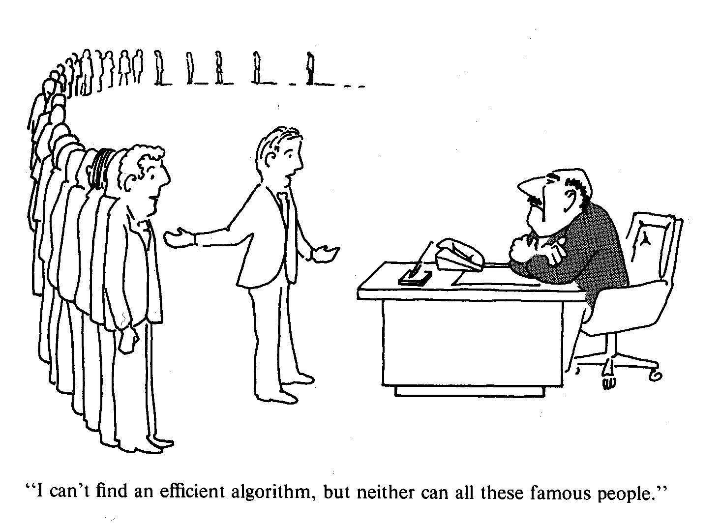
NP-Complete Problems
!
Do you are best then?

Slide 6
NP-Completeness
Some problems are intractable: as they grow large, we are unable to solve them in reasonable time
What constitutes reasonable time?
Standard working definition: polynomial time
On an input of size n the worst-case running time is O(n^{k}) for some constant k
Polynomial time: O(n²), O(n³), O(1), O(n lg n)
Not in polynomial time: O(2^{n}), O(n^{n}), O(n!)

Slide 7
Polynomial-Time Algorithms
Are some problems solvable in polynomial time?
Of course: every algorithm we have studied provides polynomial-time solution to some problem
We define P to be the class of problems solvable in polynomial time
Are all problems solvable in polynomial time?
No: “Circuit Satisfiability Problem” is not solvable by any computer, no matter how much time is given
Such problems are clearly intractable, not in P

Slide 8
NP-Complete Problems
Shortest Paths Problem
Given a weighted graph G and a source vertex s, find the minimum weight path from s to each vertex v
The running time is O(n⋅m) [Bellman-Ford Algorithm]
Longest Paths Problem
Find a longest path between two vertices
The problem is NP-Complete

Slide 9
NP-Complete Problems
Euler Tour Problem
An Euler tour of a connected graph G is a cycle that traverses each edge of G exactly once
The Euler Tour Problem is to determine an Euler tour in a connected graph
The running time is O(m)
Hamiltonian Cycle Problem
A Hamiltonian cycle of a connected graph G is a simple cycle that contains each vertex of G exactly once
The Hamiltonian cycle problem: given a graph G, does it have a Hamiltonian cycle?
The problem is NP-Complete

Slide 10
NP-Complete Problems
The well-known traveling salesman problem:
Optimization variant: a salesman must travel to n cities, visiting each city exactly once and finishing where he begins. How to minimize travel cost?
We are given a weighted complete undirected graph G, and we must find a Hamiltonian cycle of G with minimum cost
How would we turn this into a decision problem?
A: ask if there exists a TSP with cost ≤ k

Slide 11
P and NP
As mentioned, P is set of problems that can be solved in polynomial time
NP (Nondeterministic Polynomial time) is the set of problems that can be solved in polynomial time by a nondeterministic computer
What the hell is that?

Slide 12
Nondeterminism
Think of a non-deterministic computer as a computer that magically “guesses” a solution, then has to verify that it is correct
If a solution exists, computer always guesses it
One way to imagine it: a parallel computer that can freely spawn an infinite number of processes
Have one processor work on each possible solution
All processors attempt to verify that their solution works
If a processor finds it has a working solution
So, NP = problems verifiable in polynomial time

Slide 13
P and NP
Summary so far:
P = problems that can be solved in polynomial time
NP = problems for which a solution can be verified in polynomial time
P ⊆ NP
The big question: Does P = NP ? (most suspect not)
Hamiltonian-cycle problem is in NP:
Cannot be solved in polynomial time
Easy to verify a solution in polynomial time (How?)

Slide 14
NP-Complete Problems
We will see that NP-Complete problems are the “hardest” problems in NP:
If any one NP-Complete problem can be solved in polynomial time…
…then every NP-Complete problem can be solved in polynomial time…
…and in fact every problem in NP can be solved in polynomial time (which would show P = NP)
Thus: solve Hamiltonian-cycle problem in O(n¹⁰⁰) time, you’ve proved that P = NP.
Be rich & famous (Turing Award) !!!

Slide 15
Review: P and NP
What do we mean when we say a problem is in P ?
A solution can be found in polynomial time
What do we mean when we say a problem is in NP ?
A solution can be verified in polynomial time
What is the relationship between P and NP ?
Ans: P ⊆ NP, but no one knows whether P = NP

Slide 16
Reduction
A problem R can be reduced to another problem Q if any instance of R can be rephrased to an instance of Q, the solution to which provides a solution to the instance of R.
This rephrasing is called “Reducibility”
Intuitively: If R reduces in polynomial time to Q,
R is “no harder to solve” than Q
Example: lcm(m, n) = m * n / gcd(m, n),
lcm(m, n) problem is reduced to gcd(m, n) problem

Slide 17
NP-Complete and NP-Hard
What do we mean when we say a problem is in NP-Hard ?
A problem is said to be in NP-hard if every problem in NP can be polynomial-time reducible to it.
What do we mean when we say a problem is in NP-Complete ?
A problem is said to be in NP-Complete if
it is in NP-Hard, and
it is in NP
What is the relationship between NP-Hard and NP-Complete ?
NP-Complete ⊆ NP-Hard, but
No one knows whether NP-Complete = NP-Hard

Slide 18
NP-Complete and NP-Hard
What do we mean when we say a problem is in NP-Hard ?
A problem is said to be in NP-hard if every problem in NP can be polynomial-time reducible to it.
What do we mean when we say a problem is in NP-Complete ?
A problem is said to be in NP-Complete if
it is in NP-Hard, and
it is in NP
What is the relationship between NP-Hard and NP-Complete ?
NP-Complete ⊆ NP-Hard, but
No one knows whether NP-Complete = NP-Hard

Slide 19
Why Prove NP-Completeness?
Though nobody has proven that P != NP, if you prove a problem NP-Complete, most people accept that it is probably intractable
Therefore it can be important to prove that a problem is NP-Complete
Don’t need to come up with an efficient algorithm
Can instead work on approximation algorithms

Slide 20
Approximation Algorithms
Goal: Find an algorithm which returns near-optimal solution to a hard optimization problem
What does “near-optimal” mean?
An approximate algorithm has an approximation ratio of ρ(n) if for any input of size n,
max{C/C*, C*/C} ≤ ρ(n)
where C = cost of solution produced by approx. algo.
C* = cost of optimal solution
Applies to both minimization and maximization problems
Also called ρ(n)-approximation algorithm

Slide 21
Coping with NP-Hardness
Brute-force algorithms
Develop clever enumeration strategies
Guaranteed to find optimal solution
No guarantees on running time
Heuristics
Develop intuitive algorithms
Guaranteed to run in polynomial time
No guarantees on quality of solution
Approximation algorithms
Guaranteed to run in polynomial time
Guaranteed to find "high quality" solution, say within 10% of optimum
Obstacle: need to prove a solution’s value is close to optimum, without even knowing what optimum value is !

